Slide 1
Coming in a Good Way A Decolonizing Posture

Slide 2
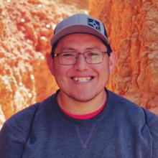
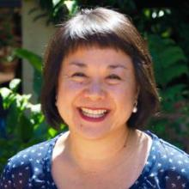
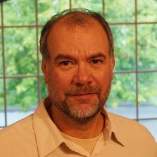
Rashawn Ramone Wendy Quay Tim Webster

Slide 4
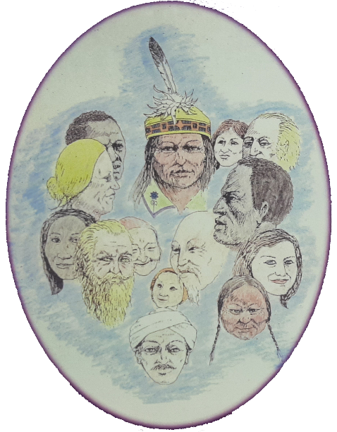
https://oneida-nsn.gov/our-ways/language/

Slide 5
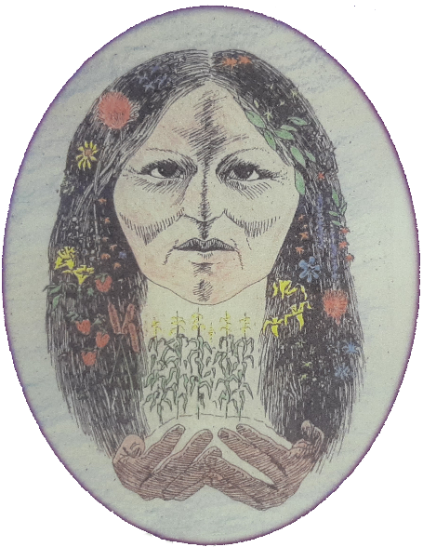

Slide 6
Coming in a Good Way
Respect
Seeing and Honoring
seeking to an understand the history (including injustices suffered), ways, and value of this community, and building a foundation of respect

Slide 7
Partner
seeking to partner, not compete,
with fellow laborers and leaders,
confident that God is already at work
with Fellow Laborers
Affirm
seeking to get behind the
concerns of this community to
help build strength from within
gifts God has
already given

Slide 8
Receive
seeking the often-unanticipated ways in which God is at work to deepen and expand our perspective, service, and self-awareness
the gifts God
has for me
Share
seeking new fruit desired by
God that is a shared success
with this community
redefine success

Slide 9
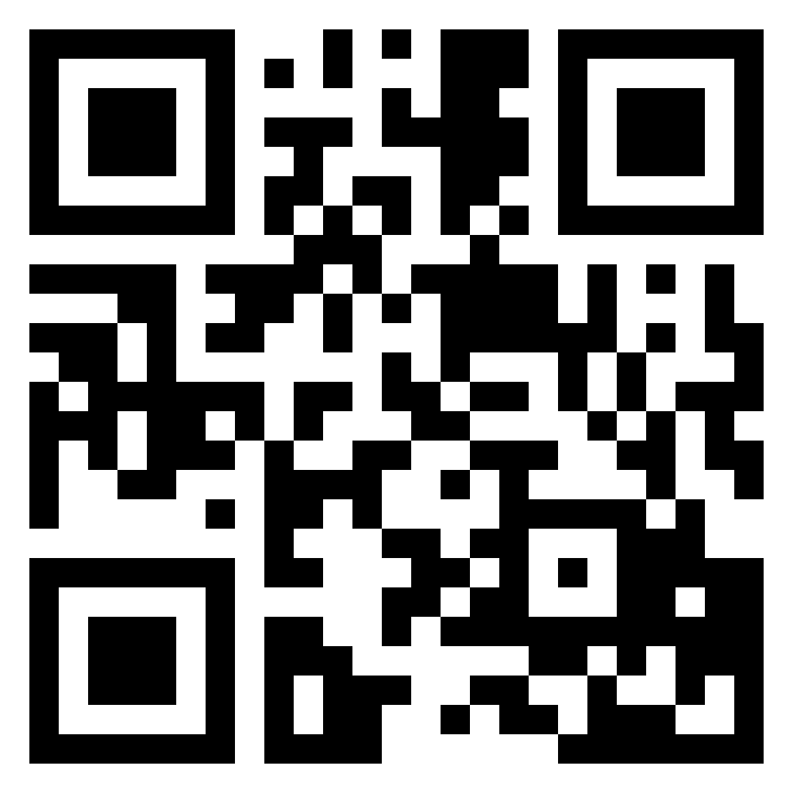
some more Coming in a Good Way resources

Slide 10
Acts 15 – The Jerusalem Council
The shift from a proselytization paradigm to a conversion paradigm
Gentiles do not have to become Jews (i.e. be circumcised) in order to be included in the people of God
Galatians 3:28 – Not saying that ethnicity, gender & social status should be ignored or erased; it’s saying that adding any of these to Christ for salvation is heresy!

Slide 11
To become a convert, … is to turn, and turning involves not a change of substance but a change of direction. Conversion, in other words, means to turn what is already there in a new direction …
Andrew Walls, Old Athens, New Jerusalem

Slide 12
Kwame Bediako on Gospel & Culture
Christ and his Gospel is prior to all cultures – Rev. 1:7; Col. 1:15
Thus Christ is in the cultural heritage of all peoples. To reject a people’s culture as valueless is to reject Christ
Within every culture, there will be strands of culture leading towards Christ, and strands leading away from him, but no culture can be discarded, and every aspect of culture must make a response to Christ

Slide 13
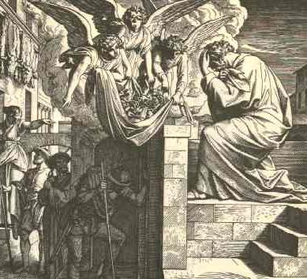
Peter and Cornelius Acts 10
The Spirit was at work amongst the Gentiles before Peter got there
The encounter was Spirit led
Two-Way Conversion – Peter was changed as well as Cornelius

Slide 15
Respect – Seeing & Honoring
How can I build a foundation of honor and respect in my relationships here?
Practicing protocol – asking permission to be invited by God & person of peace
Honoring relatives on campus – Aunties or Uncles or Grandparents
Get involved in advocacy groups or cultural activities
Prayer walks

Slide 16
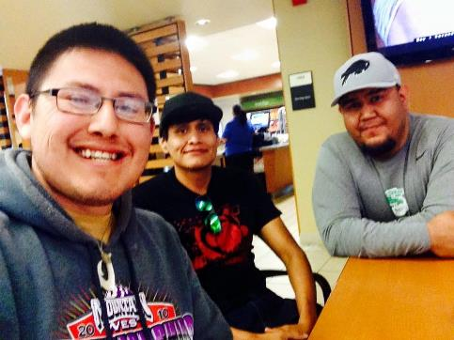
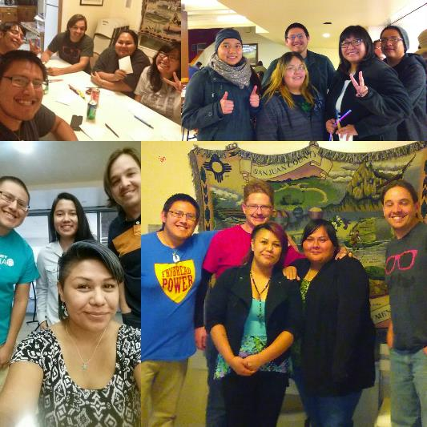
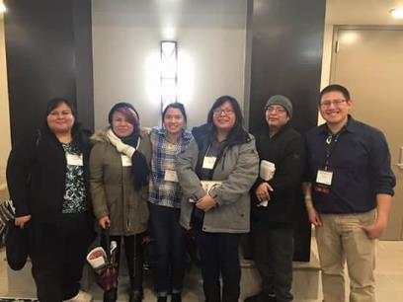
San Juan College

Slide 17
Partner – God is at work
How can I partner with what God is already doing here?
Listen & Serve ~1 semester or 2 quarters or 1 year max
Internship phase – learning & listening
Kinship – being a good relative

Slide 18
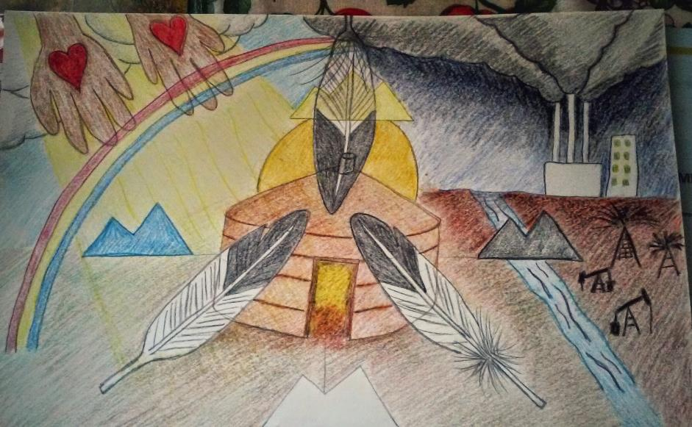

Slide 19
Affirm – God has already given gifts
How can I get behind the concerns of this community to help build strength from within?
Advocating several issues or concerns in the Native community on campus through prayer
Acknowledge what Creator God invited us to pray & serve students & faculty well
Food security
Broken relationships in households
Inaccessible to housing

Slide 20
Receive – God has gifts here for me
In what unexpected ways is God working to deepen and expand my perspective and service?
Prayer ministry
Volunteers or Eldership program
Safe places – family dinners, discipleship
LiSteN – Learn & Serve in Navajoland
Would Jesus eat Frybread? Conference

Slide 21
Share – Redefine success
What fruit does God desire that is a shared success with this community?
Self reflection
Explore your calling – Why God invited you in this space?
Responsibility & healing – common ground
Know what’s your responsibility when receiving a gift

Slide 22
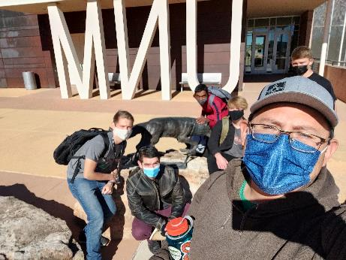
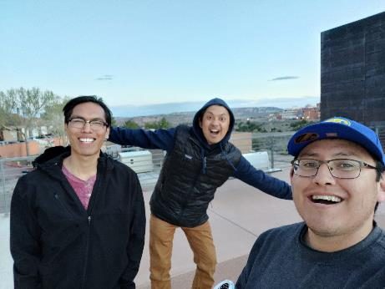
University of New Mexico – Gallup branch

Slide 23
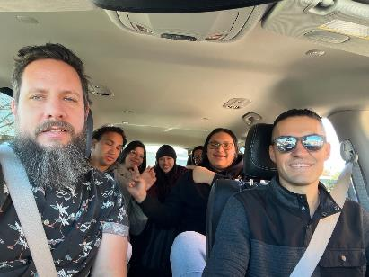
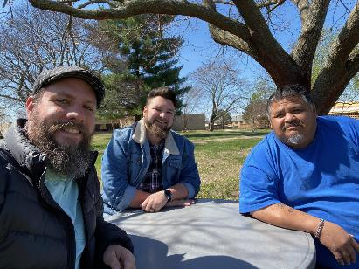
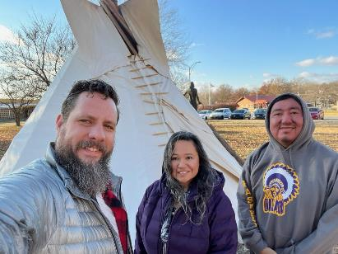
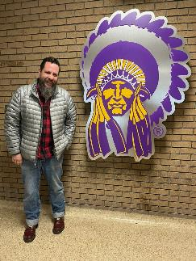
Haskell Indian Nations University

Slide 24
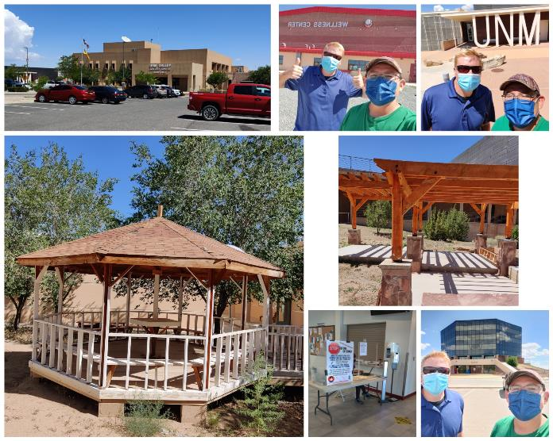
Navajo Technical University, UNM- Gallup & Dine’ College

Slide 25
Q & R

Slide 26
some more Coming in a Good Way resources

